Slide 1

A comprehensive Data Analysis of Maryland Statewide Vehicle Crashes
Varun Balle - QL24695
Sai Neelesh Kuntimala - YT93657
Dheeraj Kumar Boddu - DC32292
Meghna Aryasri – BH11498
Venkata Sridhar Perepu - SZ78217

Slide 2



Problem Statement
As a data analyst, you have been hired and given the data of the vehicle crashes happening in Maryland by the traffic police department, in order to obtain an analysis of the crashes which include high damage, and alert the public about certain scenarios and times, which might exercise more caution. The traffic department particularly wishes to know the counties where more crashes occur and the quarter in which they occur the most, while also analyzing the movement of the vehicle during the crash.

Slide 3
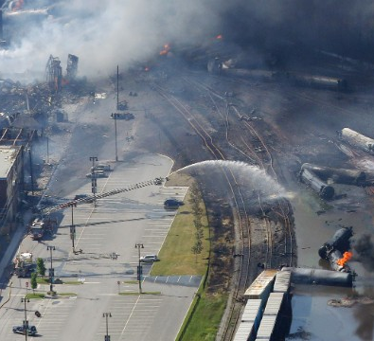
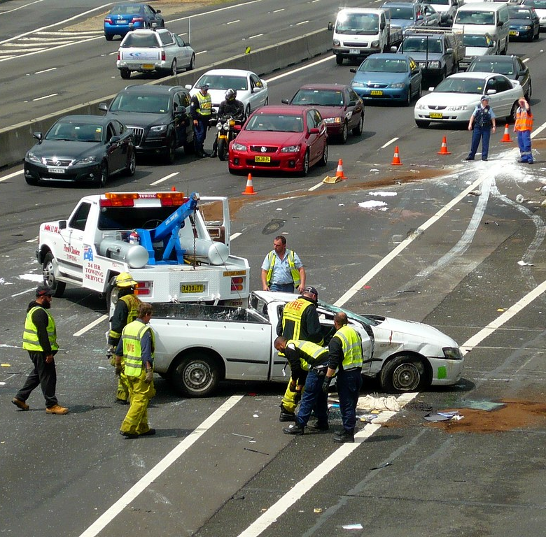
Introduction
Various factors that affect vehicle crashes in Maryland
Weather
Area
Time of the day
Road conditions
Vehicle conditions
Alcohol consumed by the driver
The database contains the details of vehicle crashes that occurred between January 2015 to June 2022.
Exploratory Data Analysis for Statistical inference and to take measures accordingly.
This Photo by Unknown Author is licensed under CC BY
This Photo by Unknown Author is licensed under CC BY

Slide 4


ER diagram
Person Details
PK → | PERSON_ID
FK → | REPORT_NO
 | QUARTER
 | YEAR
Vehicle details
PK → | VEHICLE_ID
FK → | REPORT_NO
 | QUARTER
 | YEAR
Vehicle crashes
PK → | REPORT_NO
 | QUARTER
 | YEAR

Slide 5
Description of the Dataset utilized
The dataset we used is Maryland Crash Data Resources. The data for this dataset is provided by Maryland state police. We used three datasets from this Resource page, which are the tables of our Database
Maryland_Statewide_Vehicle_Crashes have 55 columns and 848804 rows
Maryland_Statewide_Vehicle_Crashes_-_Person_Details__Anonymized have 48 columns and 1903316 rows
Maryland_Statewide_Vehicle_Crashes_-_Vehicle_Details have 49 columns and 1386222 rows
Database along with the tables is loaded in a jupyter notebook.
Crashes spanning over 7 years, in different counties, in each quarter.
Vehicle movement and weather condition effects
Notes:
8.5 lakh
19
14

Slide 6
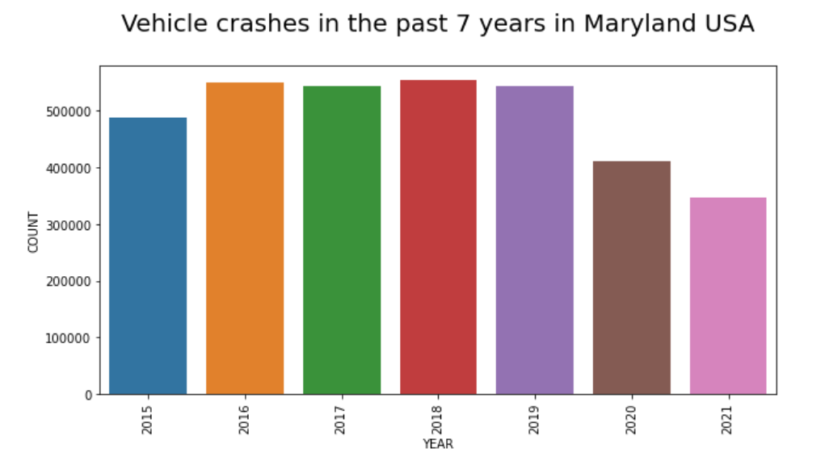

Slide 7
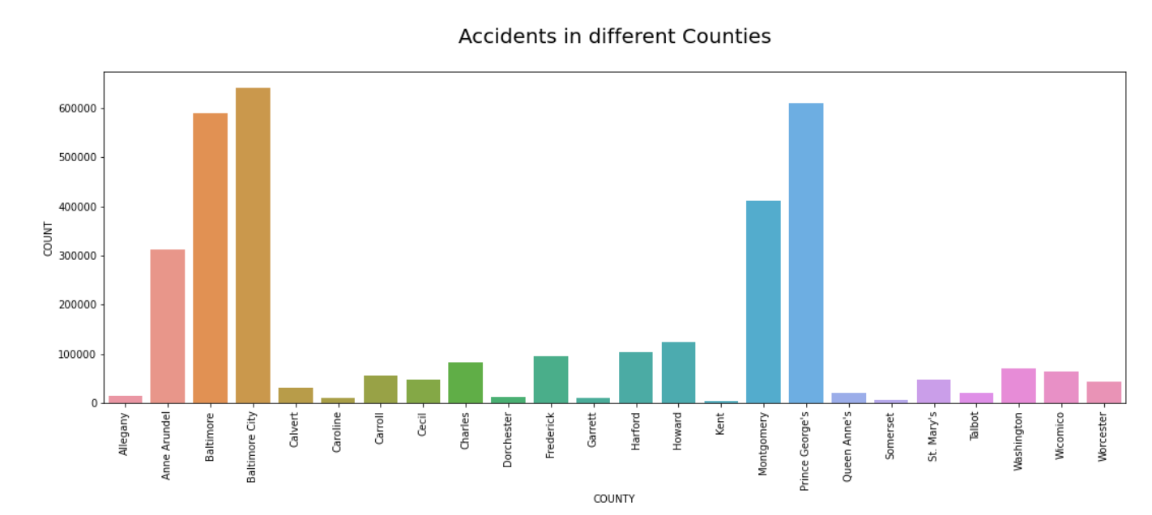

Slide 8
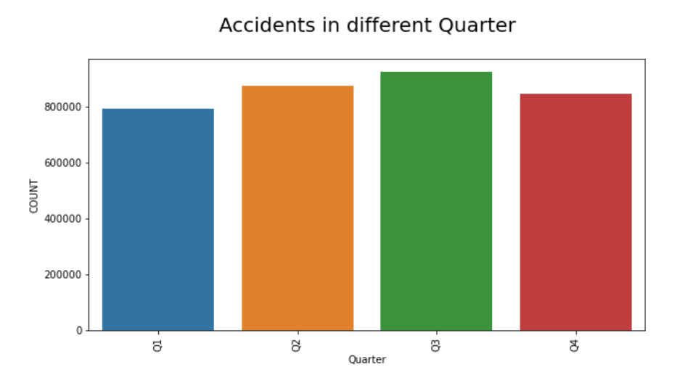

Slide 9
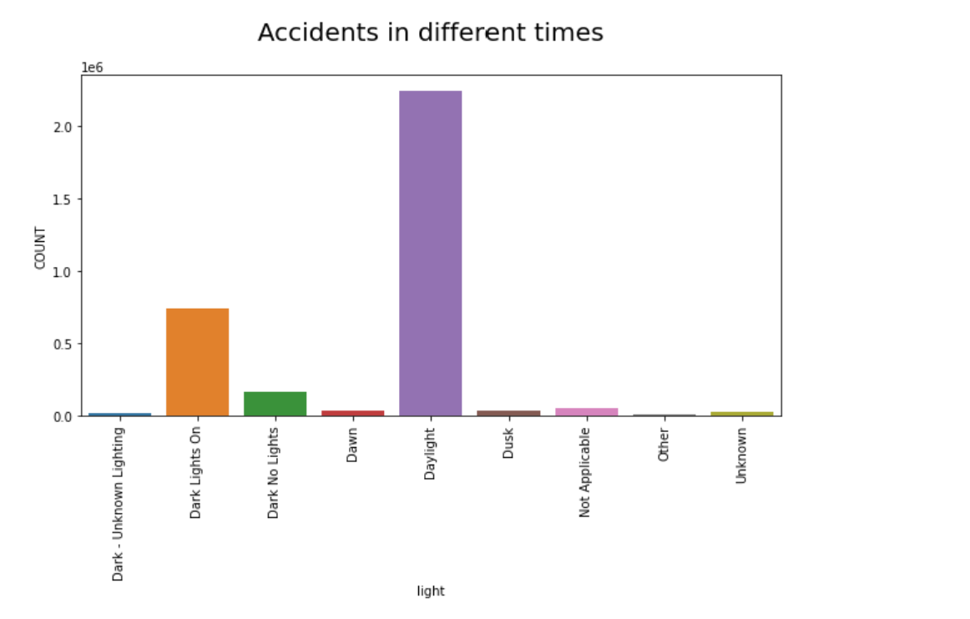
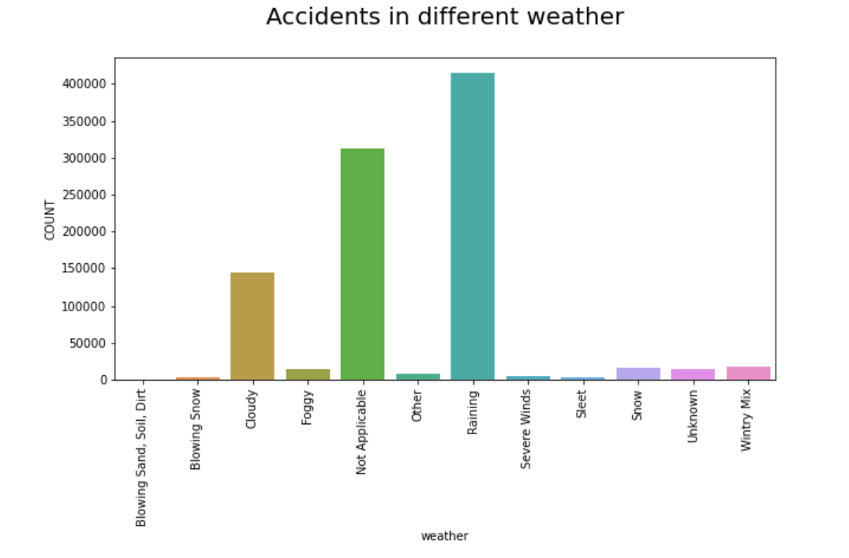
Influence of time and weather on crashes

Slide 10
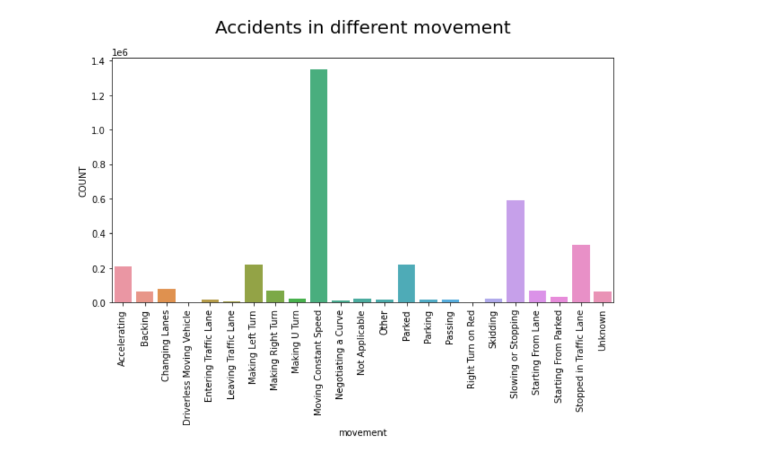

Slide 11
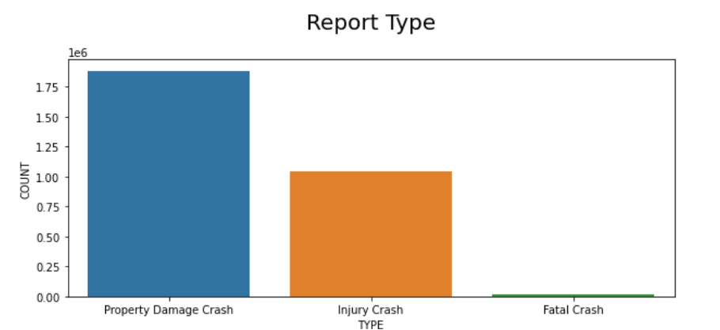

Slide 12
Observations
Maryland's dominant weather under crashes is rain followed by cloudy weather
A drop in number of crashes in 2020-21 due to the pandemic
Baltimore County has the most number of crashes followed by Prince George
Possible influence from summer break in Q3.
Most of the crashes resulted in Property damage, while fatal crashes were low.
Large number of crashes took place during daylight.

Slide 13
Discussion and future work:
We can explore if the accidents are dependent on other attributes such as gender, type of the vehicle and proficiency level of the driver etc..
From the data the most intriguing observation we found out was most crashes are occurring at the Non-Intersection junctions when compared to the Intersection junctions.
Another major work that could be done is to add certain attributes so that we can perform Association rules given data.
This information about the analysis of Maryland statewide crashes and detailed conclusion about occurrence of the accidents can be used by the insurance companies to frame a vehicle insurance policies.

Slide 14
References
Maryland Crash and Traffic Fatalities Data. (n.d.). Zero Deaths Maryland & Vision Zero - Maryland Highway Safety Office. https://zerodeathsmd.gov/resources/crashdata/
Maryland Statewide Vehicle Crashes | Open Data | opendata.maryland.gov. (n.d.). Opendata.maryland.gov. https://opendata.maryland.gov/ Public-Safety/Maryland-Statewide-Vehicle-Crashes/65du-s3qu
Willison, S. (2022, December 13). csvs-to-sqlite. GitHub. https://github.com/simonw/csvs-to-sqlite
Database Design – 2nd Edition https://opentextbc.ca/dbdesign01/

Slide 15


THANKYOU!

